Slide 1


SPARK V
Robotic Research Platform

Slide 2
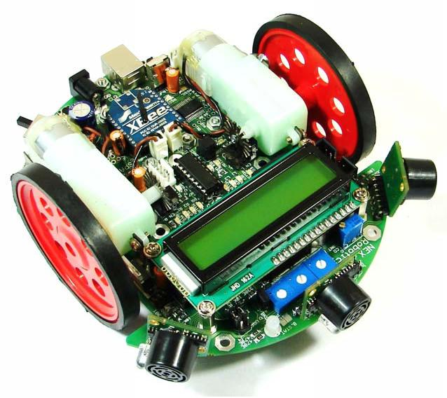
SPARK V ATMEGA 16 (AVR)

Slide 3
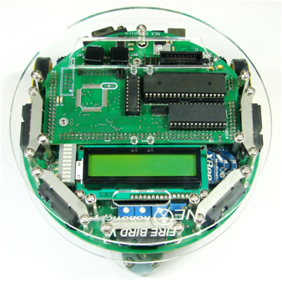
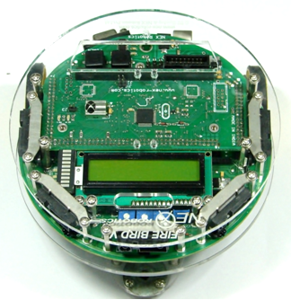
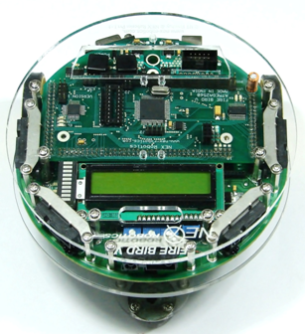
Fire Bird V Family Robots
FireBird V P89V51RD2
8051
FireBird V LPC2148 ARM 7
FireBird V ATMEGA 2560
AVR

Slide 4
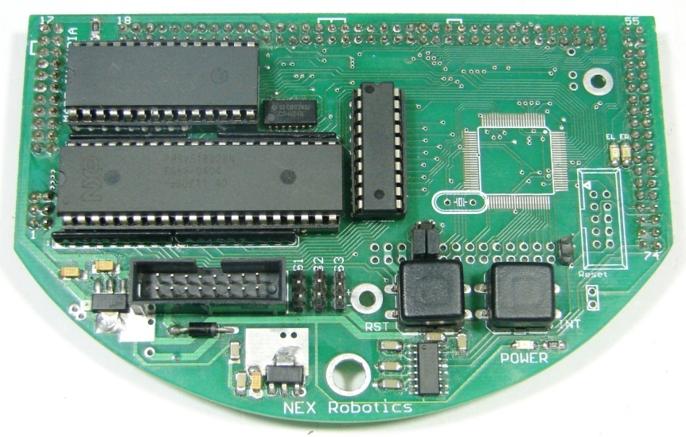
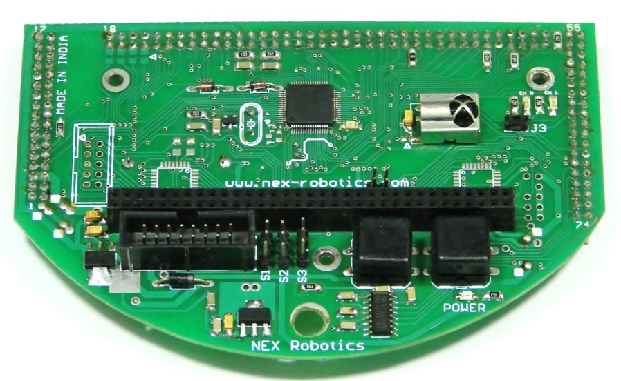
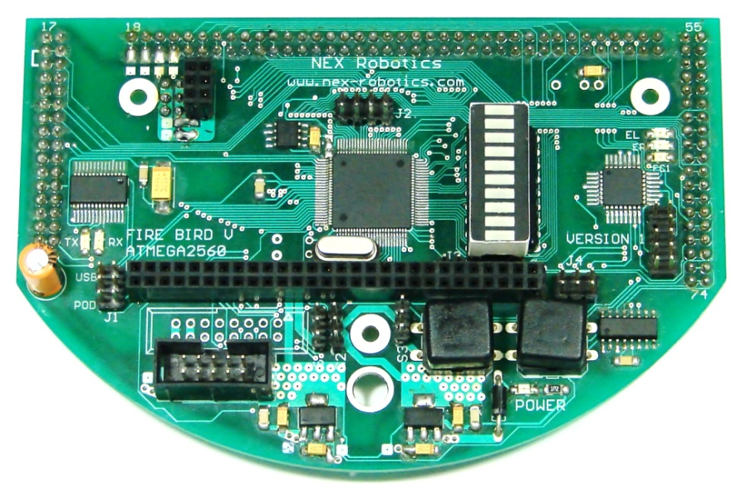
Fire Bird V uC Adaptor Boards
P89V51RD2
LPC2148
ATMEGA2560

Slide 5

Basic components of the robot
Sensing
Locomotion
Control
Intelligence
Power
Communication

Slide 6
SPARK V Technical Specification
Sensors:
Three white line sensors
Three IR proximity sensors
Three directional light intensity sensors
Two Position Encoders (optional)
MaxBotix EZ series ultrasonic range sensors (optional)
Servo mounted Ultrasonic Range Sensor (optional)
Battery voltage sensing

Slide 7
SPARK V Technical Specification
Locomotion/Actuation
Spark V is a Two wheeled Robot with a castor wheel that supports the Robot.
Two 60 RPM DC geared motors in differential drive configuration.
Top Speed: 66cm/second
L293D motor-driver controlling the direction and velocity of motor.
Intelligence
Microcontroller: ATMEL ATMEGA16

Slide 8
SPARK V Technical Specification
Indicators:
16 x 2 Alpha-numeric LCD
LED indicators
Buzzer
Battery Low Indications
Communication:
USB Communication using FT232 USB to Serial Converter
Simplex infrared communication (From infrared remote to robot)
ZigBee (IEEE 802.15.4) (Wireless)(Robots to Robots and Robots to PCs )(Optional)

Slide 9
SPARK V Technical Specification
Programming:
Using NEX Robotics Boot loader via USB port (no need of separate programmer)
Power:
6 AA size NiMH rechargeable batteries.
AC adaptor with exact 12V DC with 1Amp. current rating for battery charging.

Slide 10
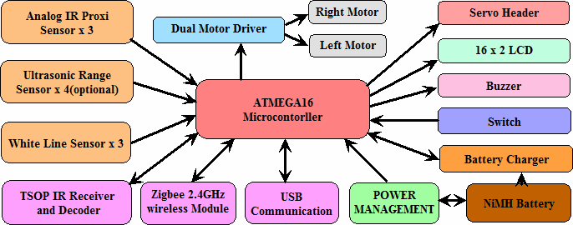
SPARK V Functional Block Diagram

Slide 11
Features: ATMEGA16
High-performance, Low-power AVR 8-bit Microcontroller
Advanced RISC Architecture
Up to 16 MIPS Throughput at 16 MHz
32 Programmable I/O Lines
16K Bytes of In-System Self-programmable Flash program memory
512 Bytes EEPROM
1K Byte Internal SRAM
Four PWM Channels
8-channel, 10-bit ADC
Byte-oriented Two-wire Serial Interface (I2C)
Programmable Serial USART
Master/Slave SPI Serial Interface
Programmable Watchdog Timer

Slide 12
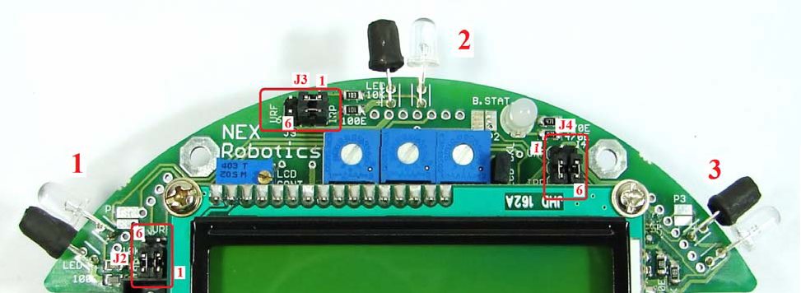
IR proximity and Directional light intensity sensors

Slide 13
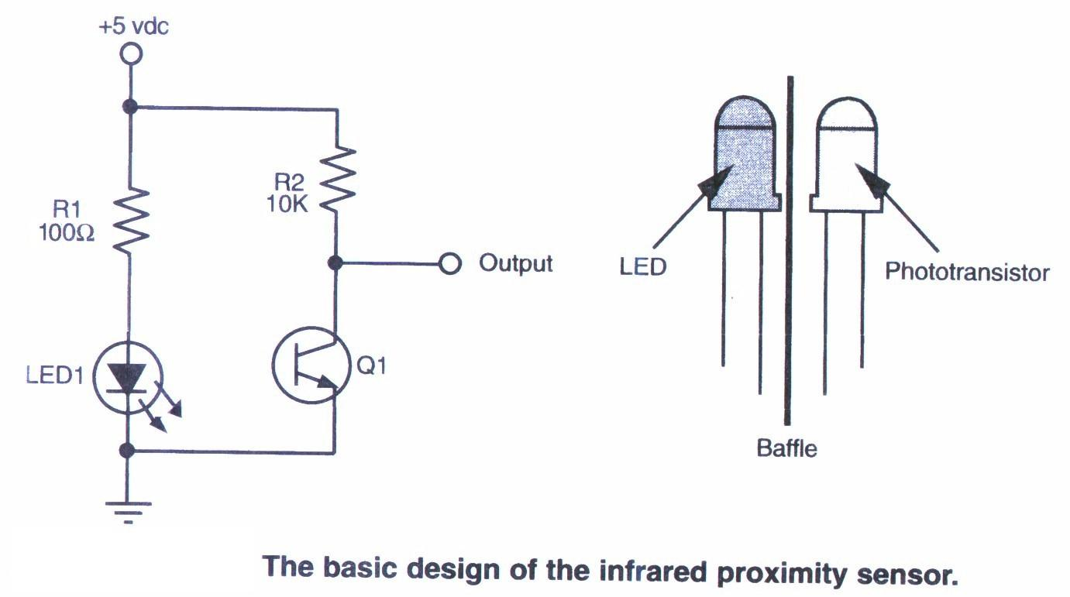
IR proximity and Directional light intensity sensors

Slide 14
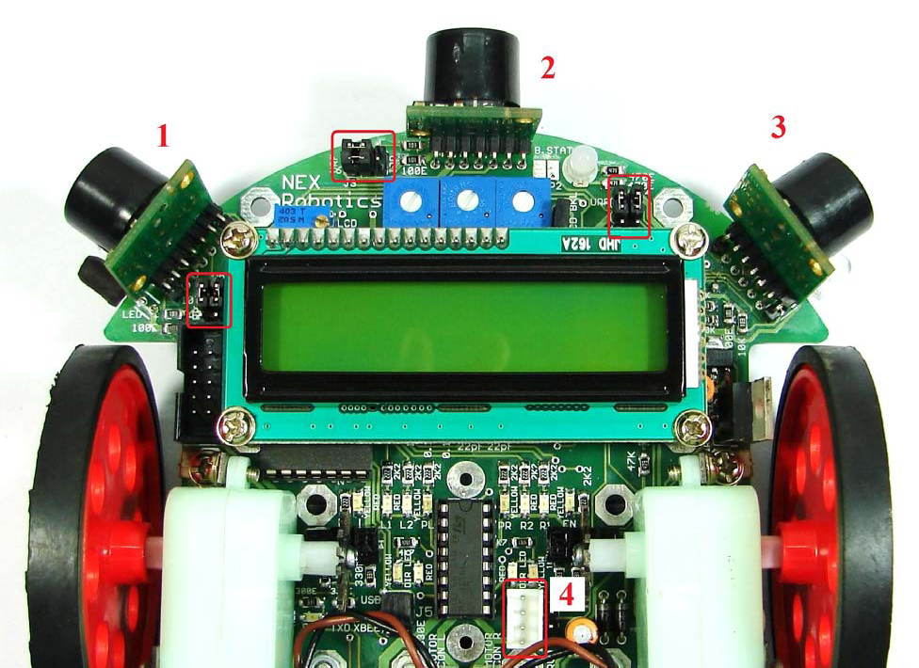
Ultrasonic range sensor

Slide 15
Ultrasonic range sensor
Spark V robot can be equipped with the 4 ultrasonic sensors from MaxBotix.
Three sensors are mounted just above the 3 IR proximity sensors.
4th Sensor can be mounted on the servo motor for taking 180 degrees scan for map making (marked as 4).
Each sensor can sense distance range from 6 inches to 254 inches.
Spark V robot supports EZ0 to EZ4 series of ultrasonic range sensors from MaxBotix.
Sensor gives out analog output with 1 inch resolution. It gives output voltage of 9.8mV per inch.

Slide 16
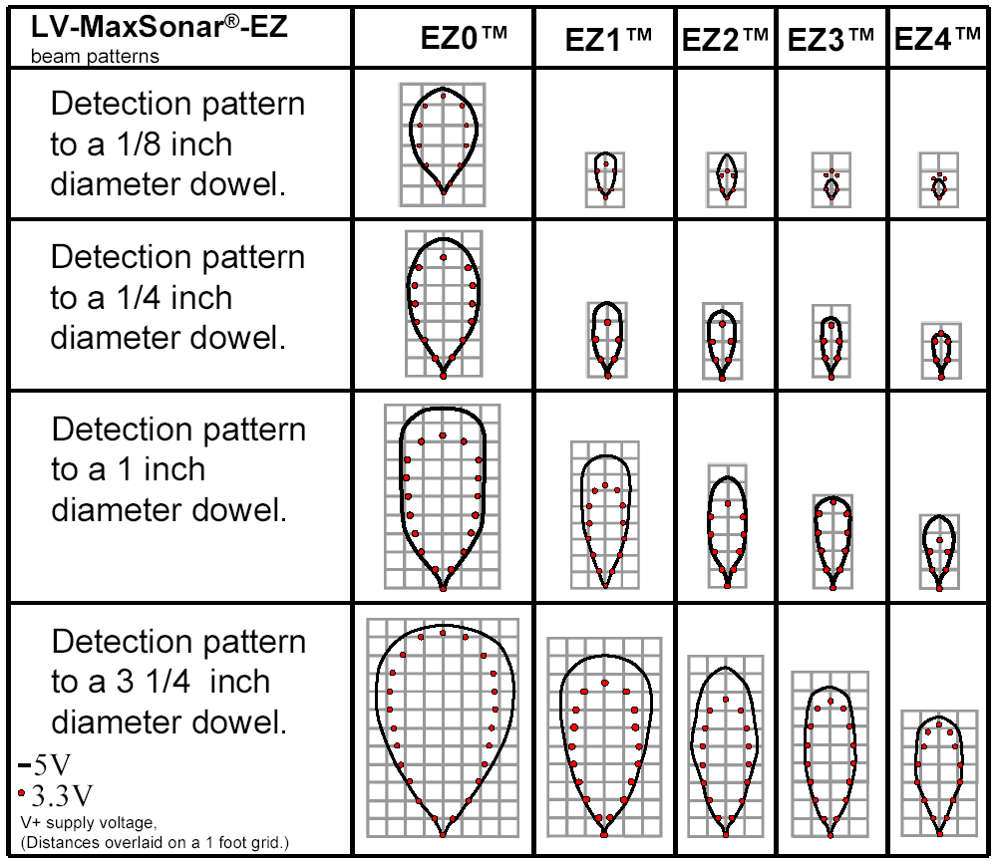
Ultrasonic range sensor

Slide 17
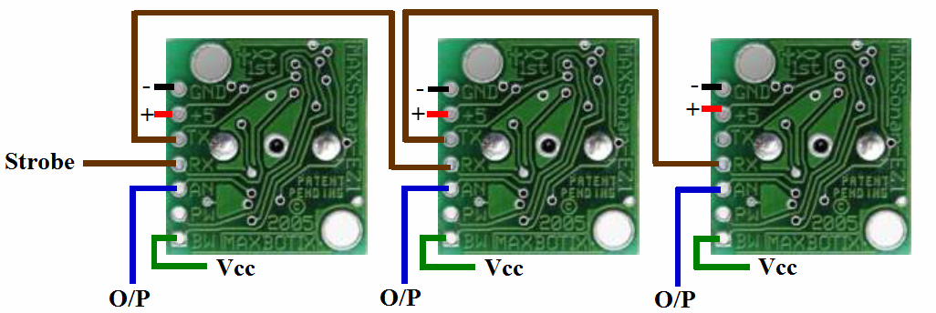
Ultrasonic range sensor
A small pulse trigger (more than 100uS) is given to the “RX” pin of the Sensor no. 1 from the microcontroller’s PD6 pin.
Sensor 1 transmits ultrasonic pulse and gives out distance reading within 49mS.
Sensor 1 triggers the Sensor 2 by transmitting a small pulse on its TX pin to the RX pin of the second sensor.

Slide 18
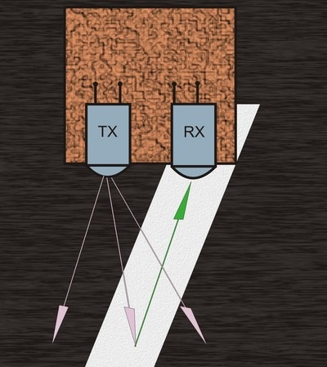
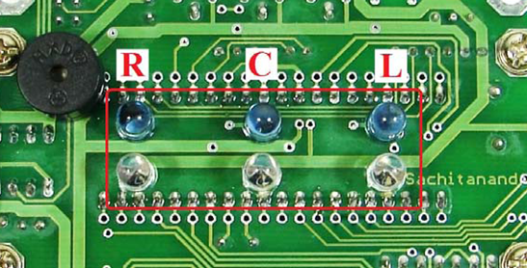
White Line Sensor

Slide 19
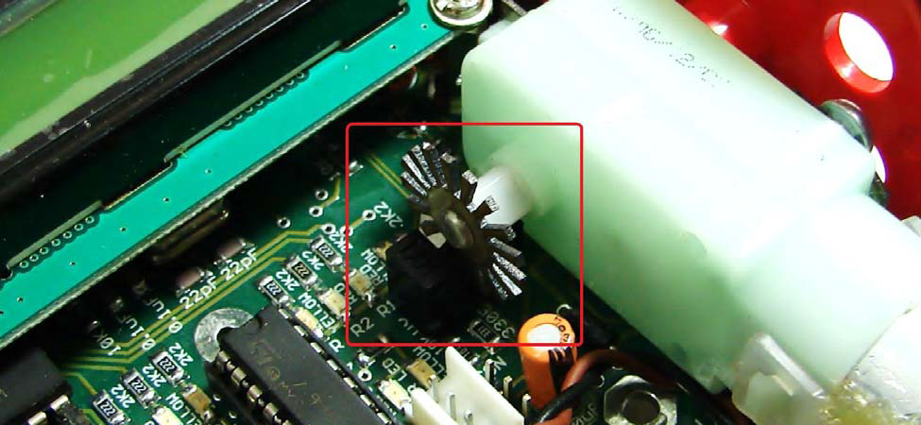
Positions Encoders

Slide 20
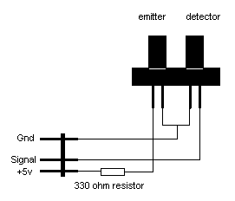
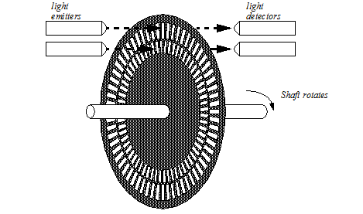
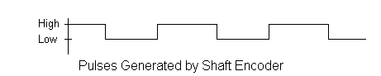
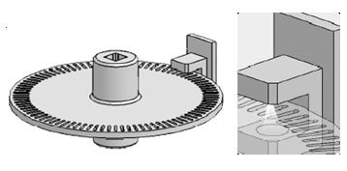
Position Encoders

Slide 21
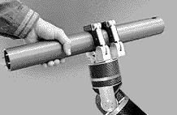
Thank
You

